Slide 1
Friends of Burhill school
www.friendsofburhillschool.co.uk
Annual General Meeting
8pm Thursday 5th Oct 2017

Slide 2
Who are we?
Parents, guardians, carers, grandparents, teachers, teaching assistants, non-teaching staff, volunteers…
WE ARE ALSO:
Class Reps
Class Rep Mentor, Media Relations, Website Secretary, Fundraisers, Community Liaison, Event Organisers…
Secretaries, Tresurers, Vice-Chairs and Chair

Slide 3
Why are we here?
To raise money to purchase equipment to support our expanding school and enhance the learning of all the children at Burhill School.
Provide a supportive community for all our families at Burhill and our local community.
because we love our school!

Slide 4
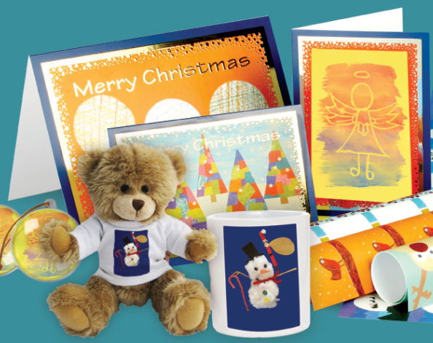
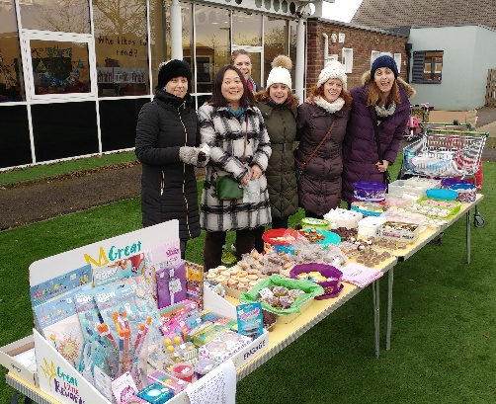
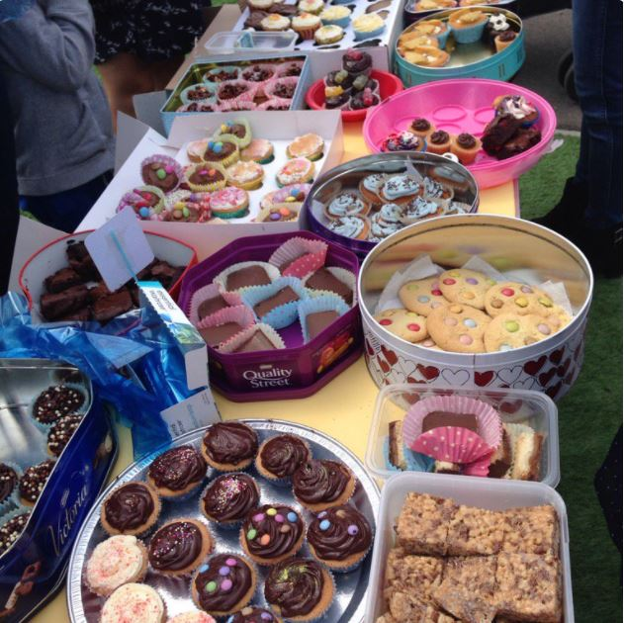
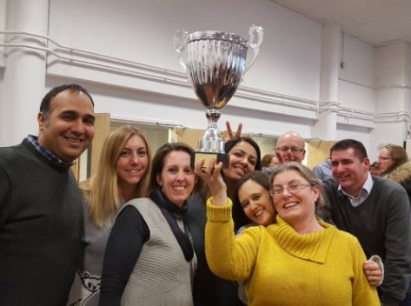
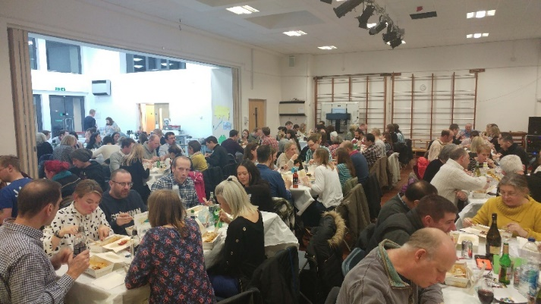
How do we raise money?
Cake bakes
Christmas Cards
Quiz Nights
Secondhand Uniform Sales
Ice Cream Sales
School Discos
Strictly Beauty & Bling

Slide 5
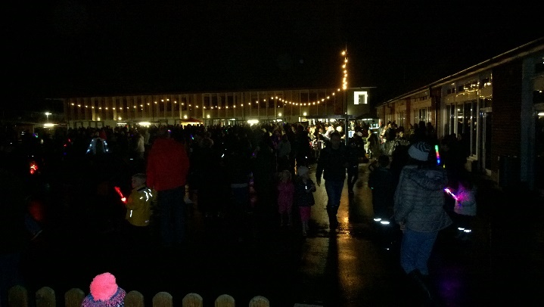
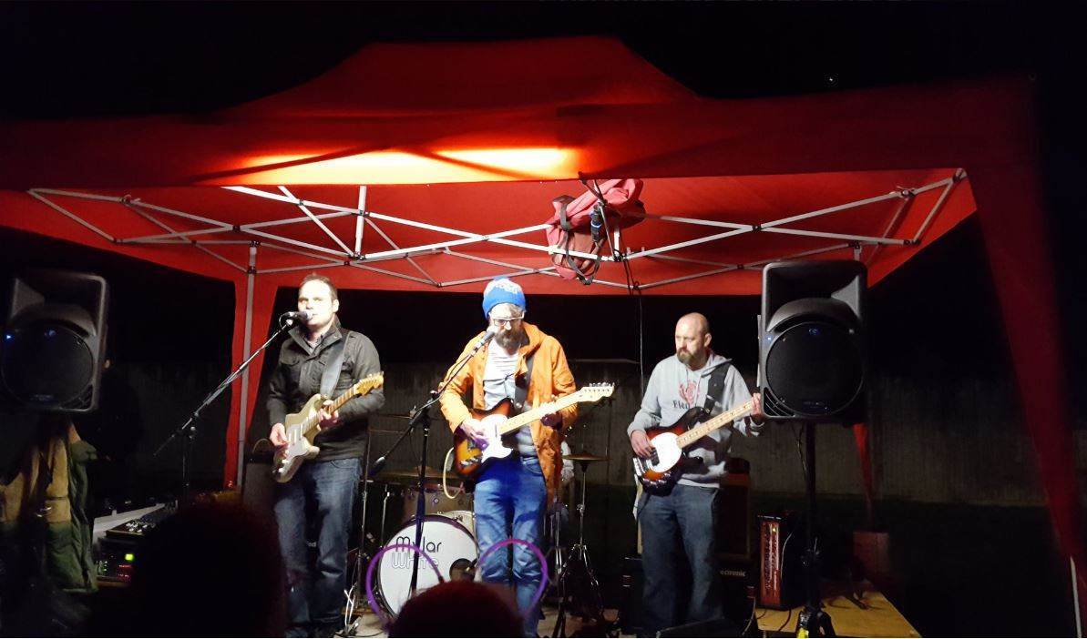
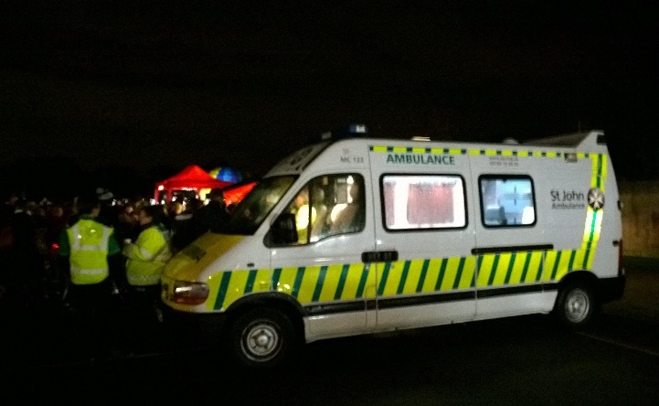
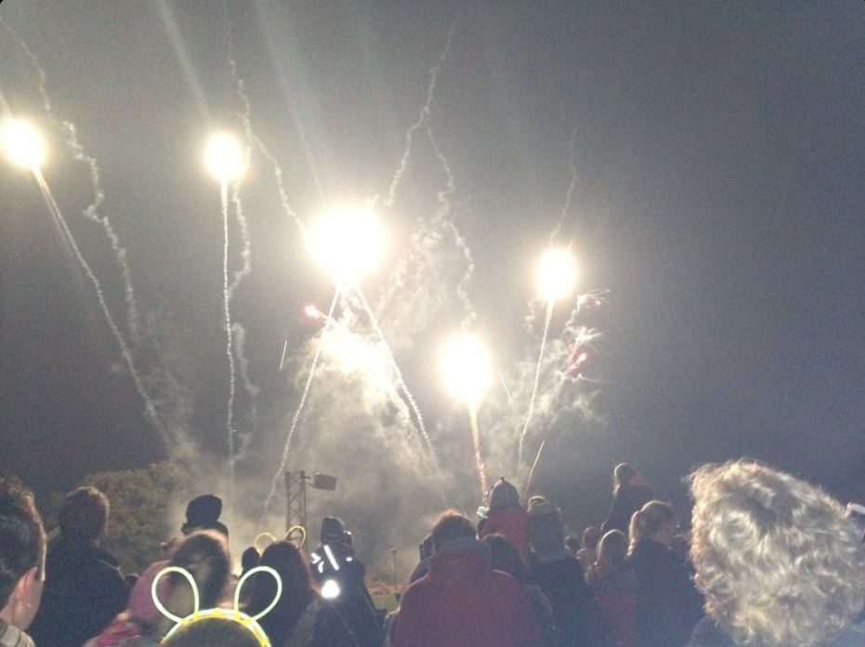
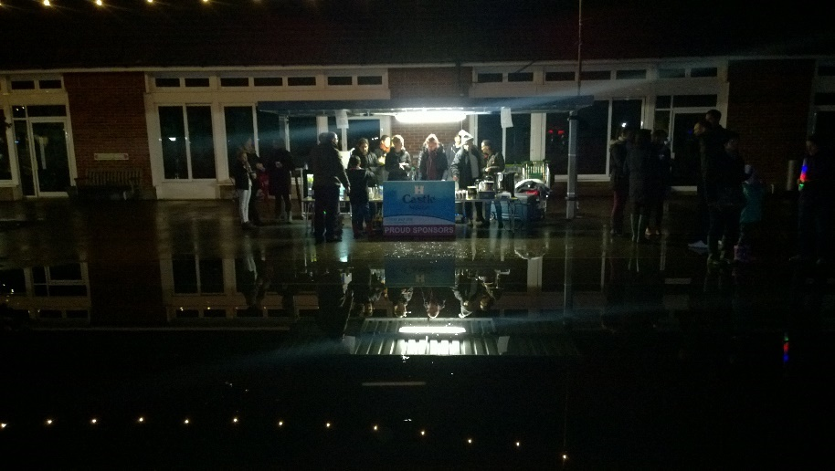
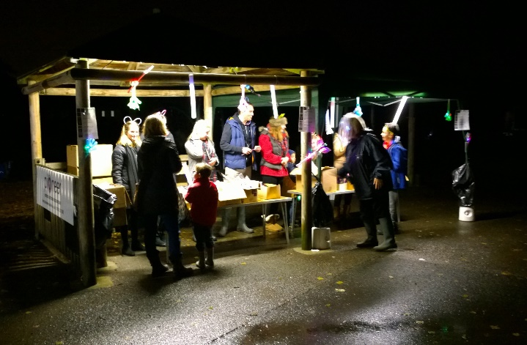
Fireworks
Raised just over £5,000

Slide 6
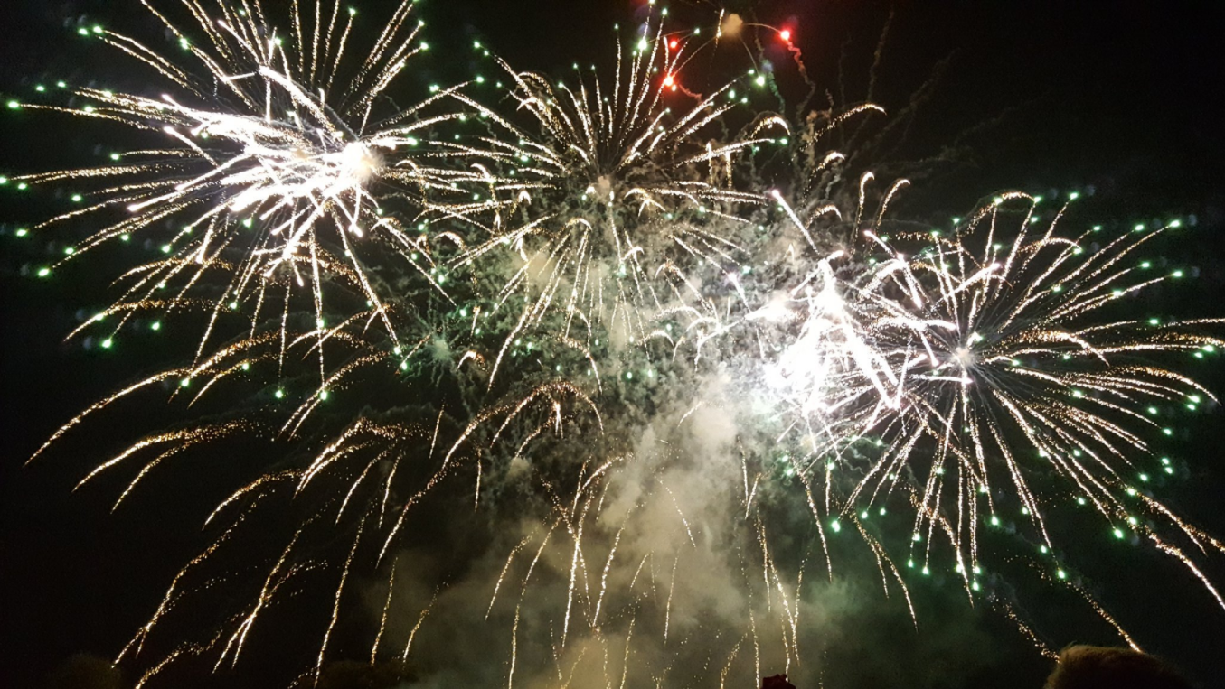

Slide 7
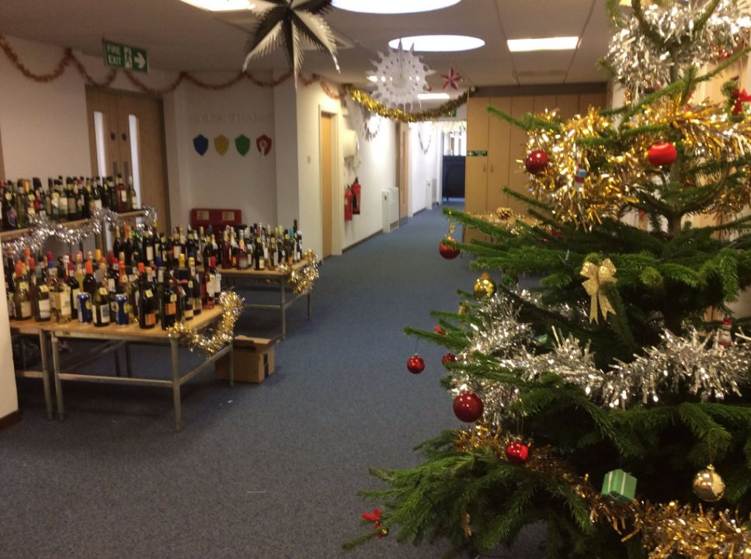
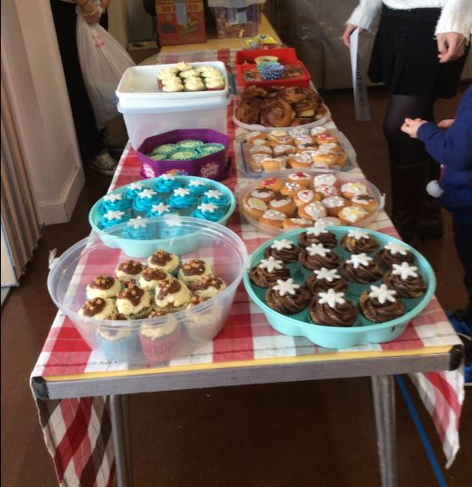
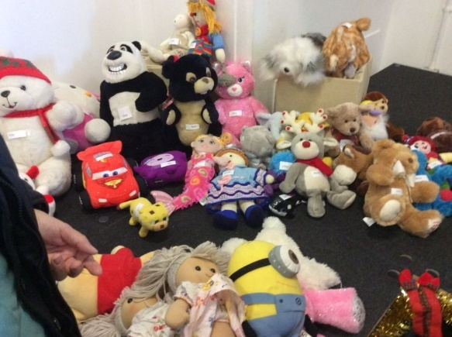
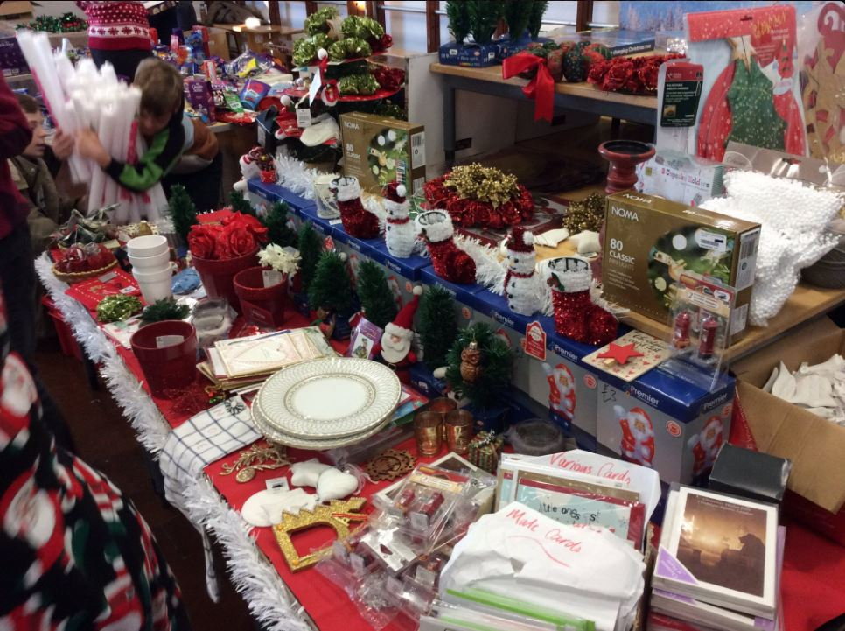
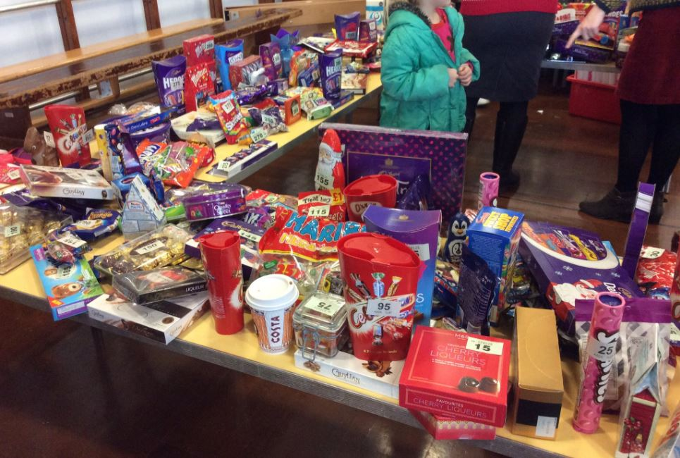
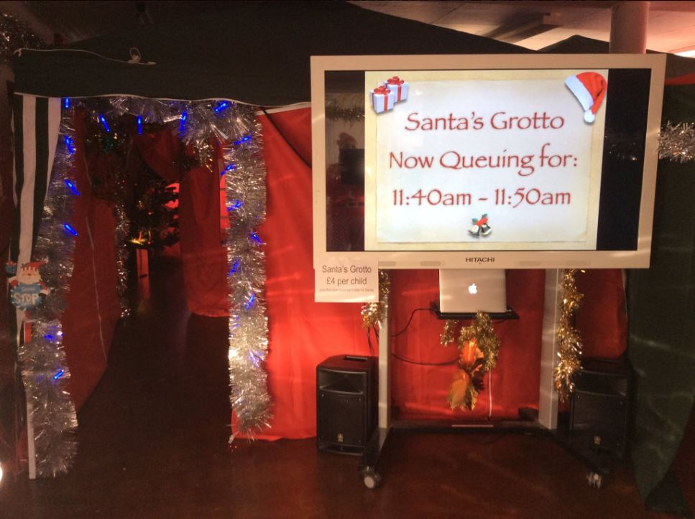
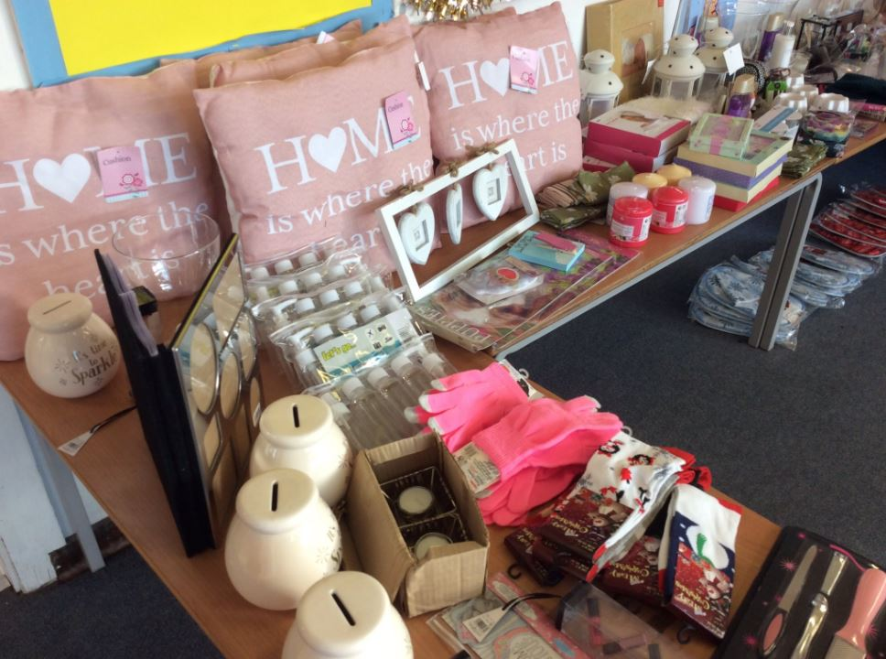
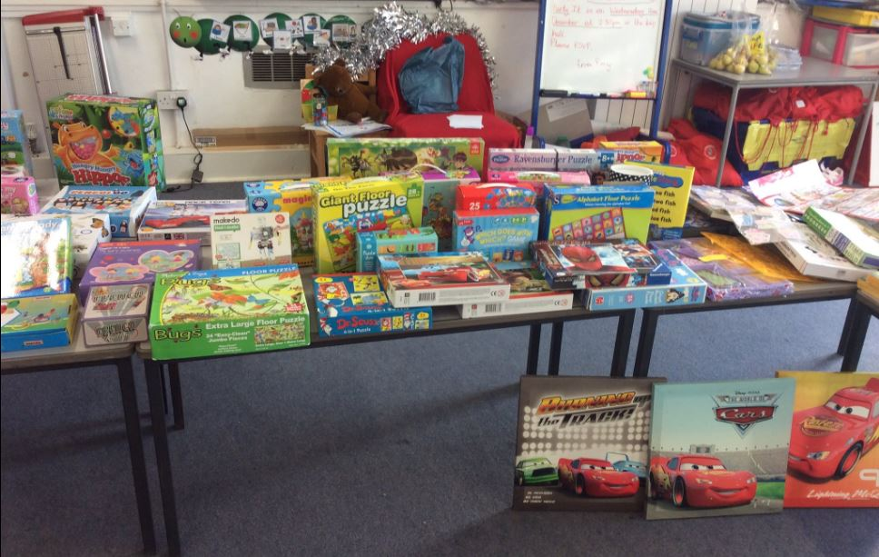
Christmas fair
Raised £2,774

Slide 8
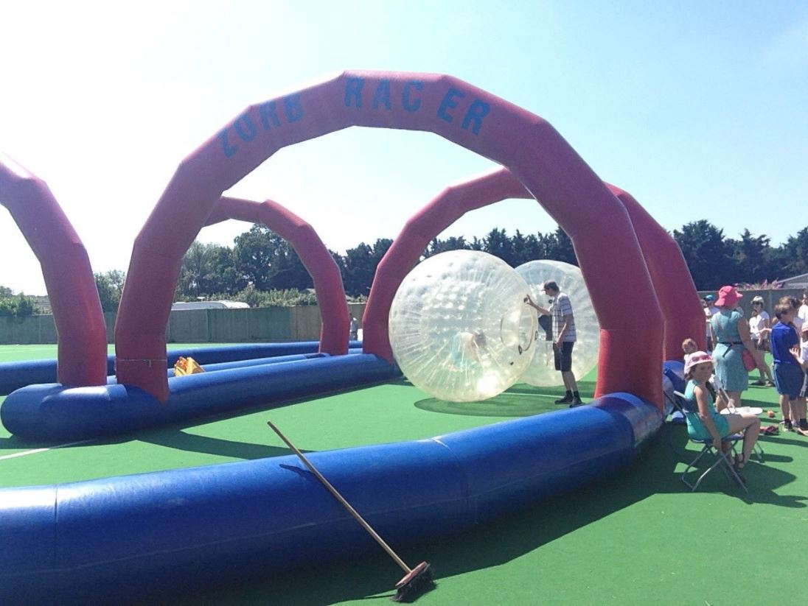
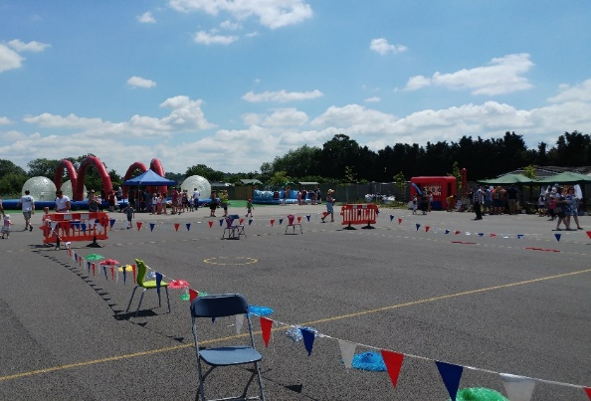
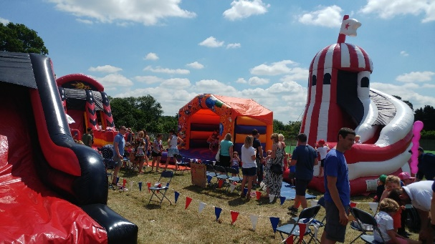
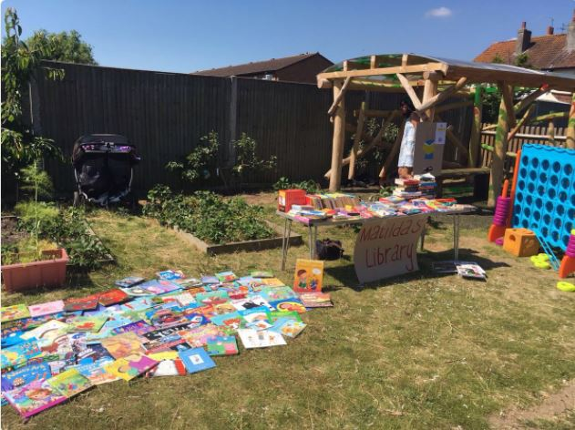
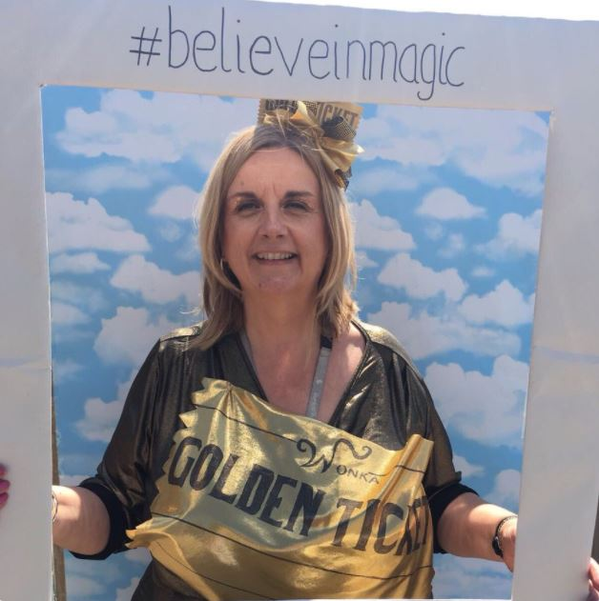
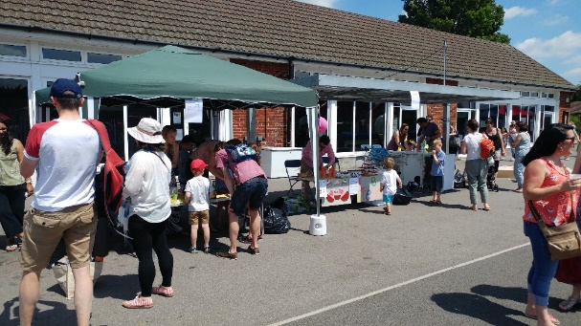
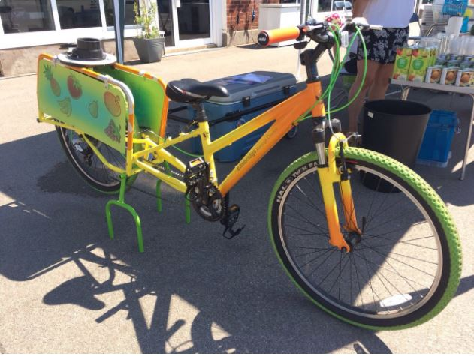
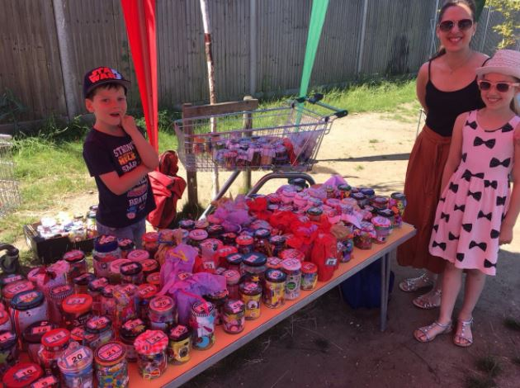
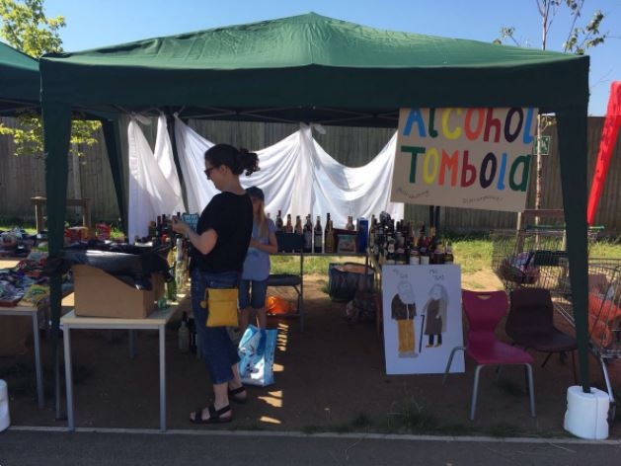
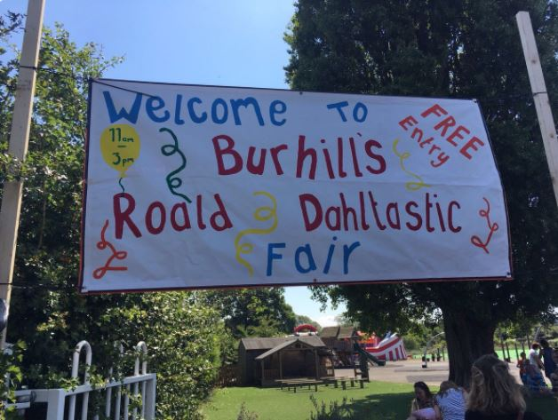
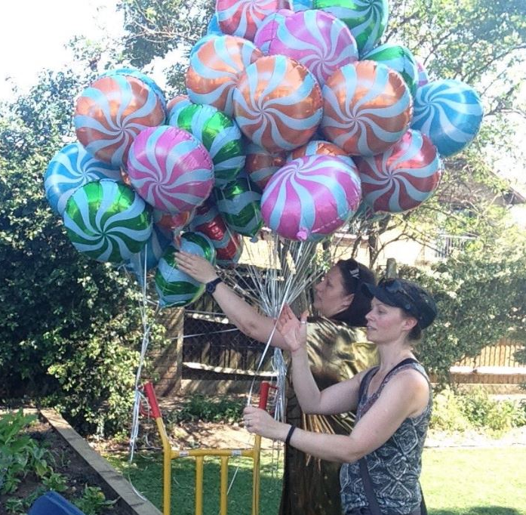
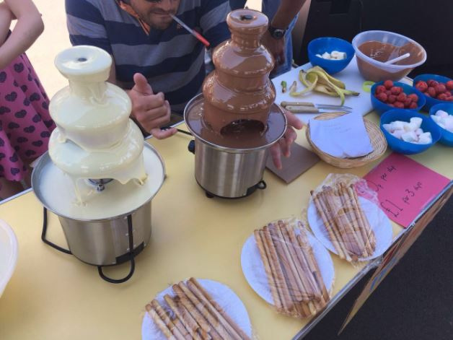
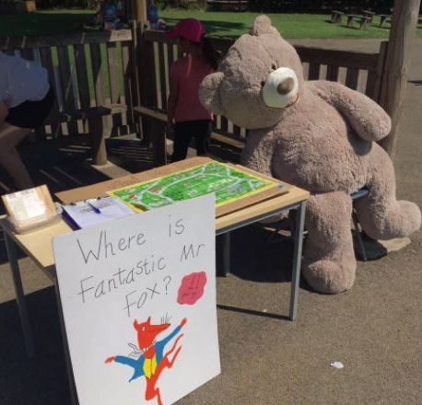
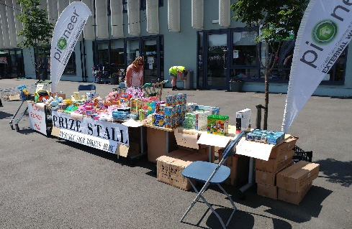
Summer fair
Raised £2,373

Slide 9
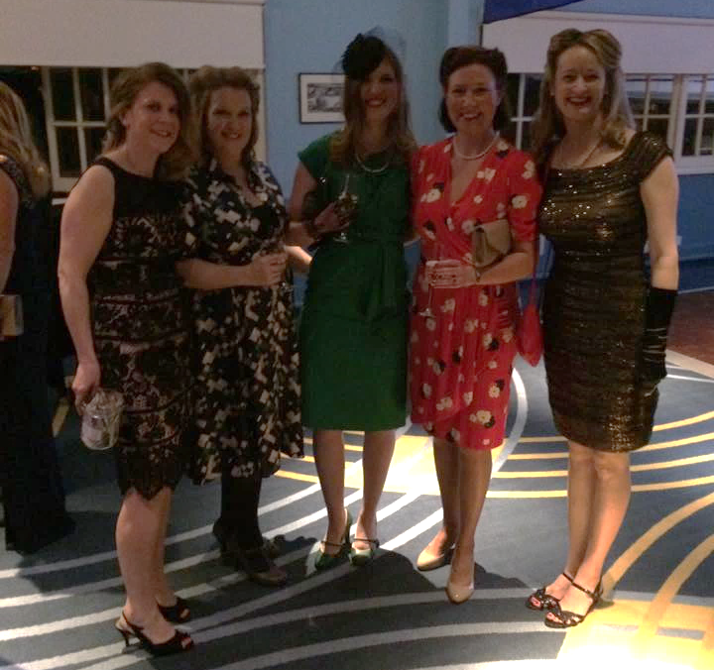
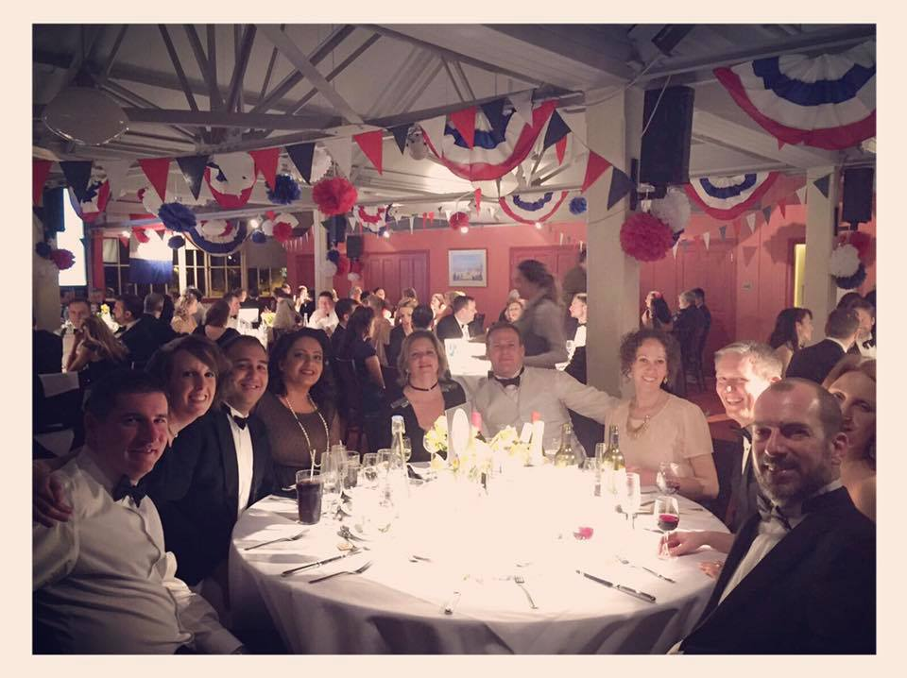
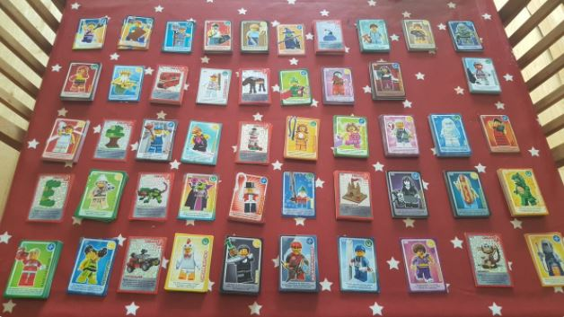
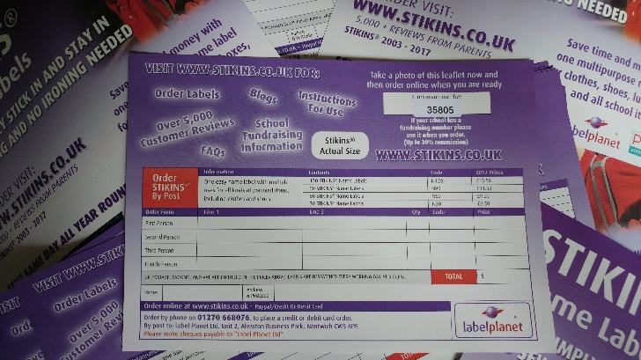
Burhill Ball – Raised over £8,000
Tea Towels
Easy Fundraising
Employer Matched Funding
And more…
… new ideas always welcome!
Lego Cards
Stikins Labels

Slide 10
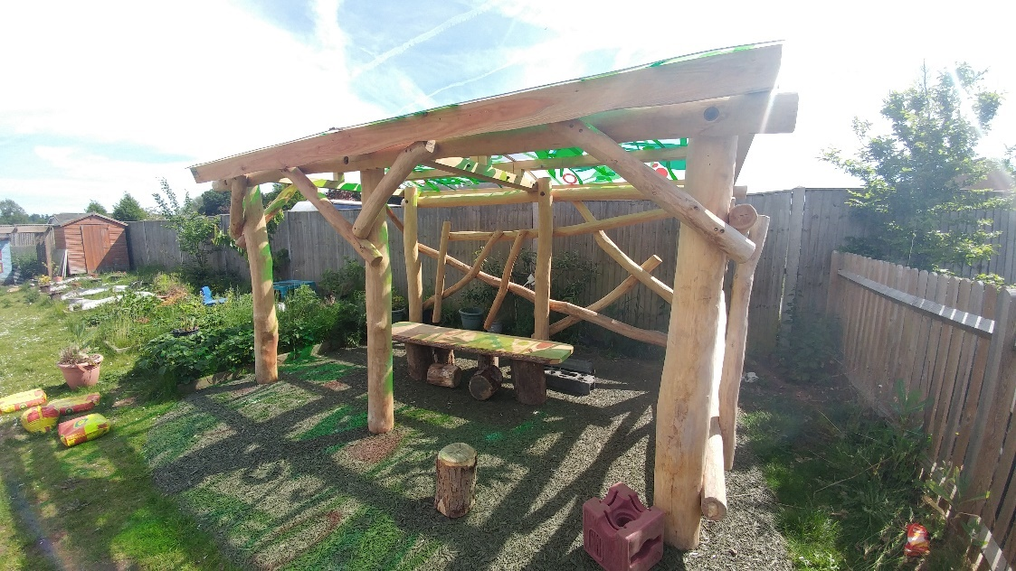
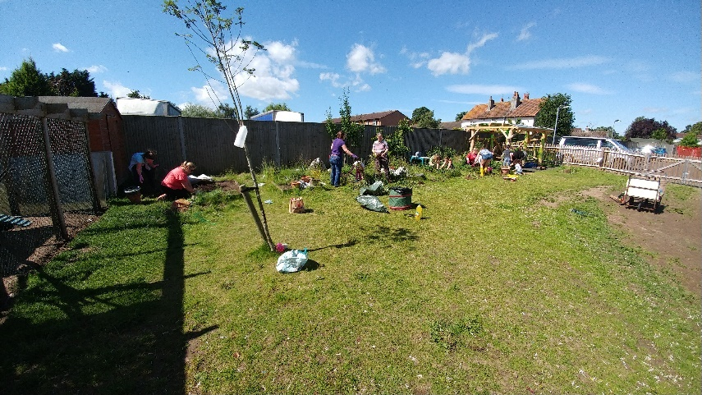
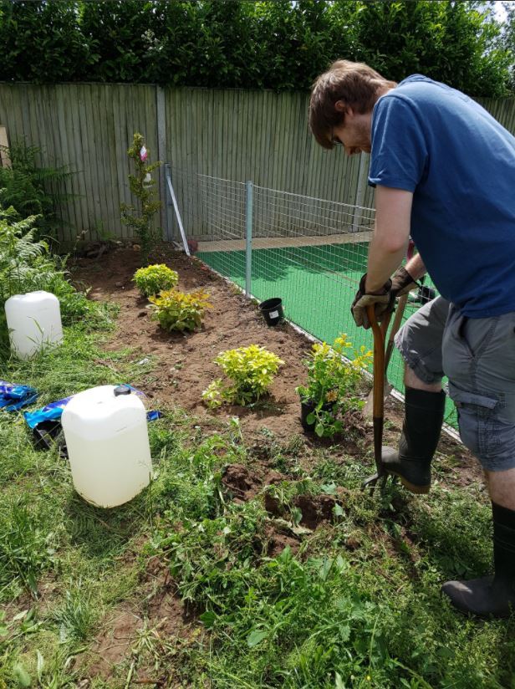
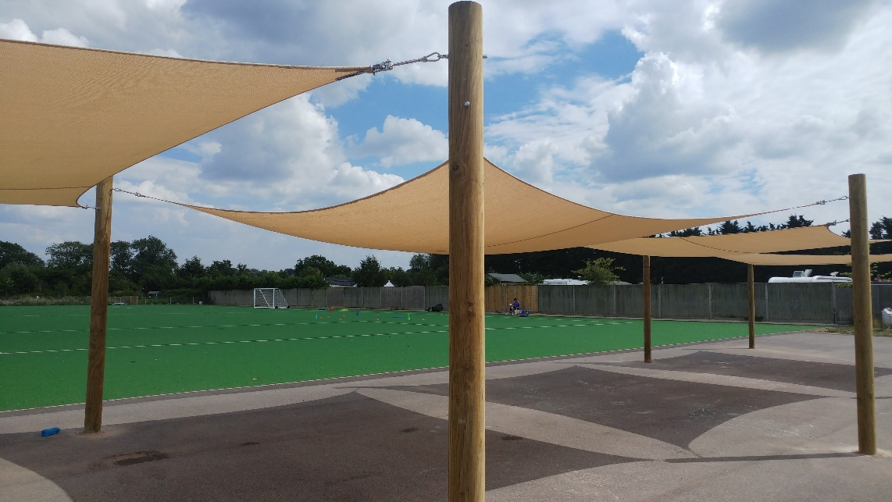
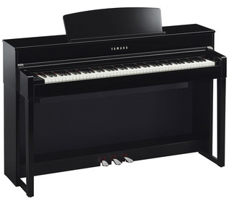
What have we bought?
£1,655
£12,848
£10,000
£2,482

Slide 11
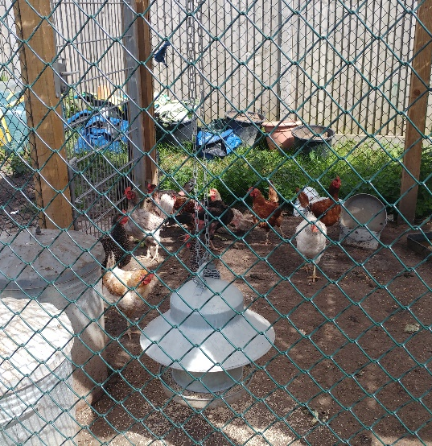
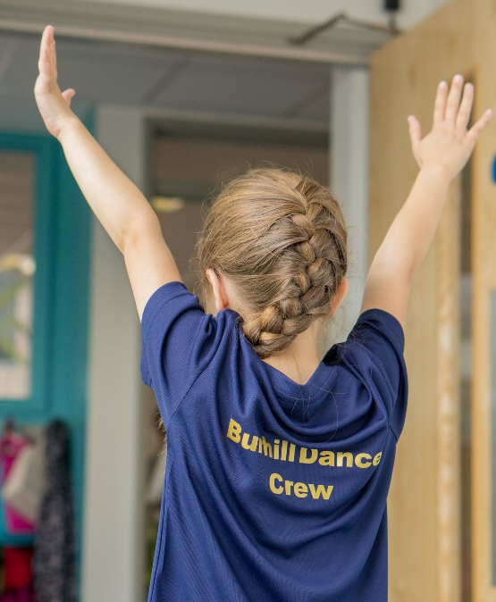
We’ve also bought:
EYFS Market stall and wooden water wall
Netball hoodies and skorts
Dance T-shirts
Hockey Sticks
Chickens
Guinea Pigs and cage
VTech cameras
12 class sets of reading books
And much more...

Slide 12
What else do we do?
We do lots of things to support the school, such as speaking to new parents, serving tea and coffee at meetings and providing refreshments to the children during school events.
We have provided:
Juice and biscuits for Stories by Candlelight
£100 available for every teacher
Ice Lollies at Sports Day
Easter Eggs
A gift from Santa
A visit from Reindeer
Refreshments during Parent Consultations
Decorating the school at Christmas
Hardship Fund
Gardening ‘parties’
And many other things...

Slide 13
THE FINANCIAL REPORT

Slide 14
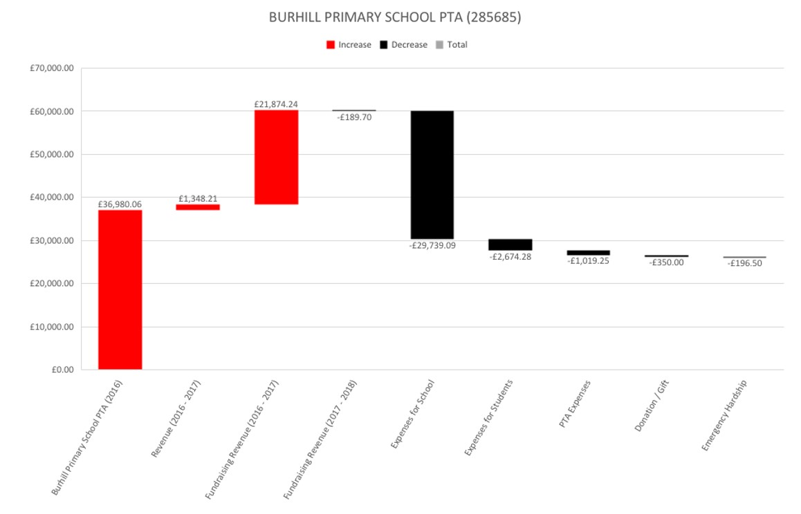

Slide 15
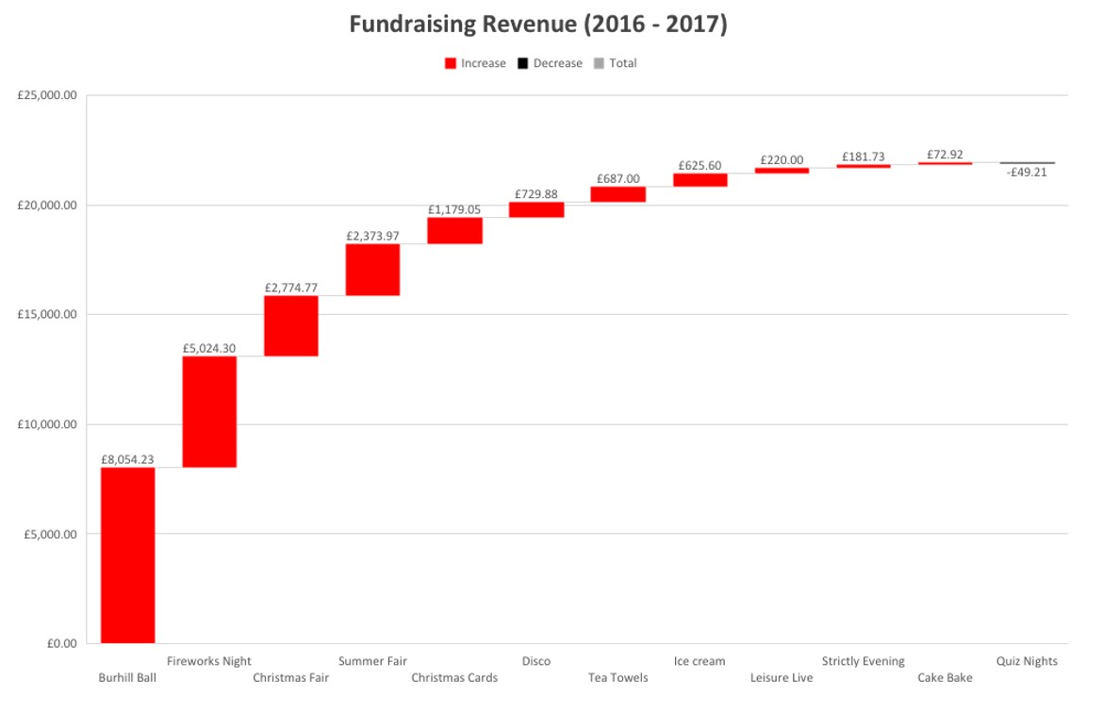

Slide 16
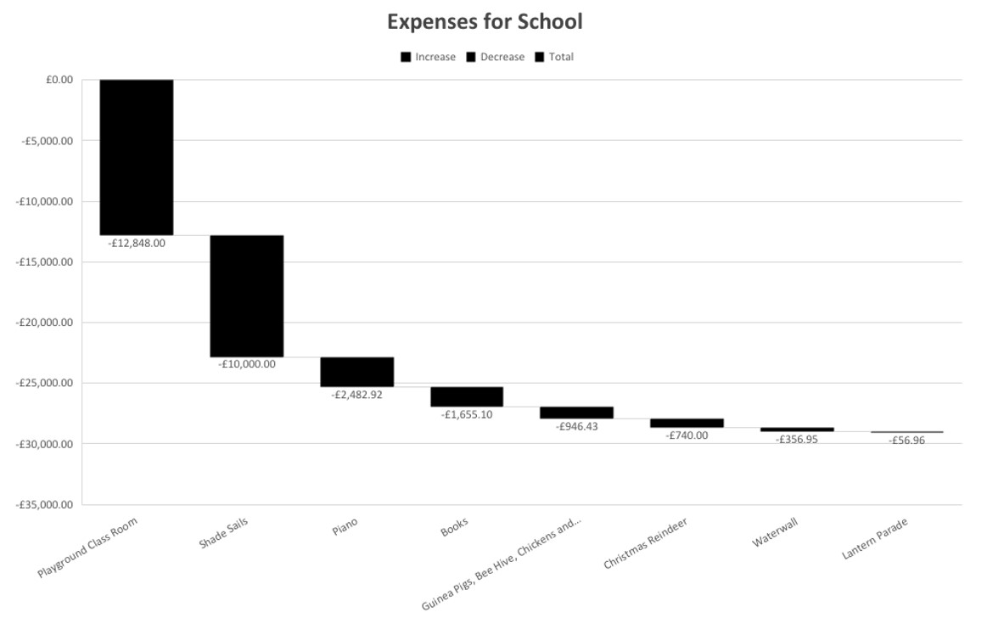

Slide 17
THANK YOU
Committee Members Stepping down:
Hans
Claire
Amira
Heather
Adele

Slide 19
NEW CHAIR OR CO-CHAIRS NEEDED!
Prepare for meetings (with the Secretary) suggest items for the agenda, identify outstanding items from last meeting
Delegate tasks to other members and volunteers, and check they are completed
Liaise with the school and request a ‘wish list’ for the committee to agree what to fund
Ensure the committee fulfils its role in respect of governance of the association as set out in the constitution, for example holding an AGM, election of committee, working with the Treasurer to ensure annual returns are completed
Ensure any decisions made are clear, fit the objects of the constitution, and by agreement of the committee
Write the annual report for the association (with the Secretary)
From www.pta.org.uk

Slide 20
Questions?
Good reasons to volunteer:
Improve the school's facilities, community spirit and partnership with parents
Socialise and get to know each other whilst taking part in a range of activities
Share common concerns and find solutions, working with the school
Find out more about how the school works, developing effective partnerships with the teaching and non-teaching staff
Fundraise for extra items or services to enrich the children's education
Increase your own knowledge and skills
Come and have a chat…

Slide 21
The general election The committee
Treasurers
Secretaries
Chair
Vice-Chair
Non – committee positions
Community Liaison
Class Rep Mentor

Slide 22
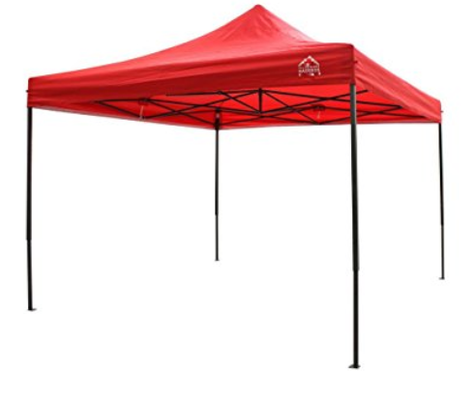
Let’s spend some money…
£129.99 Amazon

Slide 23
Check out our website: www.friendsofburhillschool.co.uk
Email us: hello@friendsofburhillschool.co.uk
Follow us on Twitter: @BurhillFoBS

Slide 24
Next meeting – Monday 6th November
Fri 3rd Nov Fireworks Night – 5pm to 7.30pm
Thu 30th Nov Decorate the school!
Sat 2nd Dec Christmas Fair – School hall
Sat 17th Mar Burhill Ball - TBC
Sat 16th Jun Summer Fair
Thank you for coming!

